Slide 1



Marvel vs DC Box Office Comparison
A Data Visualization and Comparative Analysis of Cinematic Universe Performance
16010123012 Aaryan Sharma
16010123017 Aditey Kshirsagar
16010123023 Aditya Baheti
Notes:
1

Slide 2
Objectives of Analysis
This study examines four key dimensions of Marvel and DC cinematic performance.
1
2
Total Revenue Comparison
Individual Movie Performance
Compare aggregate box office revenue across both franchises.
Analyze per-film earnings to identify top performers and outliers.
3
4
Revenue Trends Over Time
Consistency & Success Patterns
Study how box office performance has evolved across release years.
Evaluate the reliability and predictability of each franchise's output.
Notes:
2

Slide 3
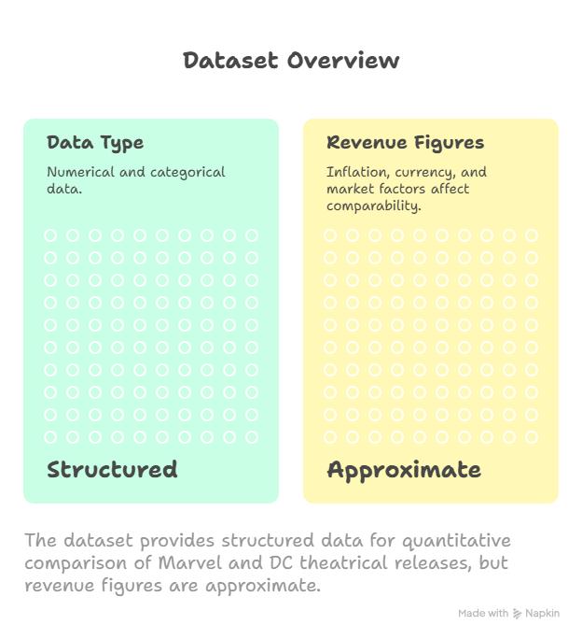
Data Source & Metadata
Dataset Overview
A custom-compiled dataset covering Marvel and DC theatrical releases, structured for quantitative comparison.
Data Type
Structured numerical and categorical data
Limitations
Revenue figures are approximate; inflation, currency fluctuations, and external market factors may affect comparability across years.
Notes:
3

Slide 4
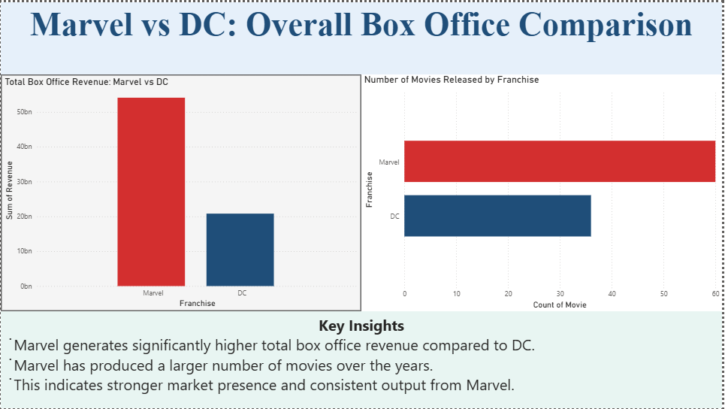

Notes:
4

Slide 5
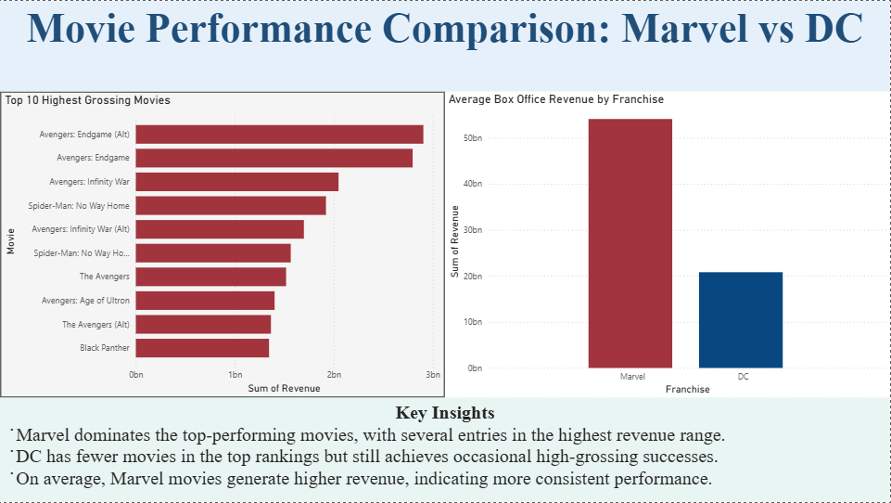
Notes:
5

Slide 6
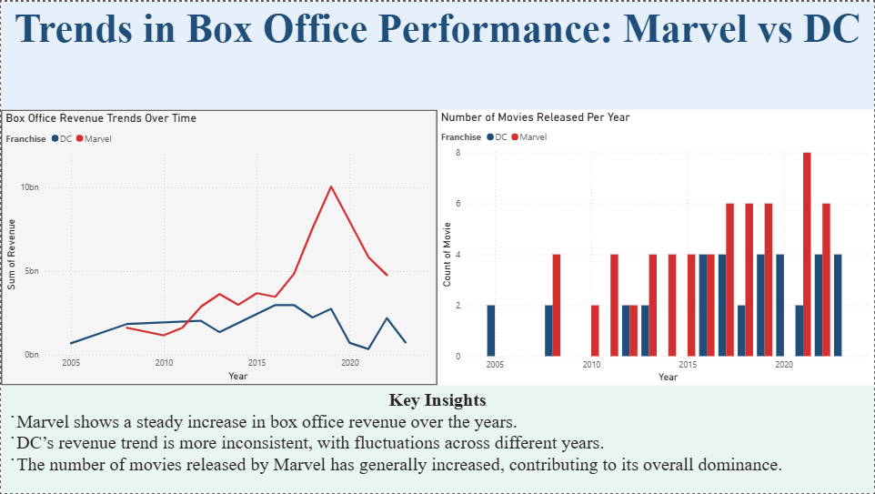
Notes:
6

Slide 7
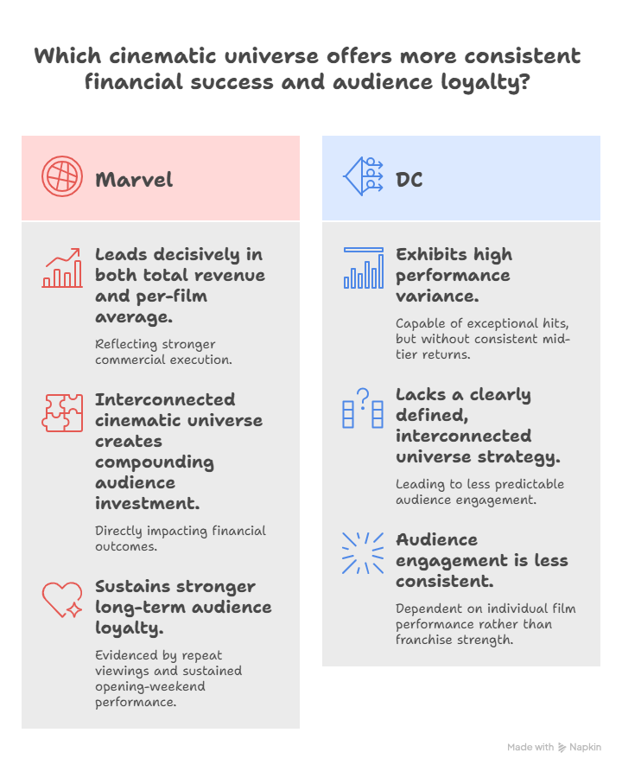
Interpretation – Key Findings
Revenue Leadership
Marvel leads decisively in both total revenue and per-film average, reflecting stronger commercial execution.
DC Variability
DC exhibits high performance variance — capable of exceptional hits, but without the floor of consistent mid-tier returns.
Franchise Strategy
Marvel's interconnected cinematic universe creates compounding audience investment, directly impacting financial outcomes.
Audience Engagement
Marvel sustains stronger long-term audience loyalty, evidenced by repeat viewings and sustained opening-weekend performance.
Notes:
7

Slide 8
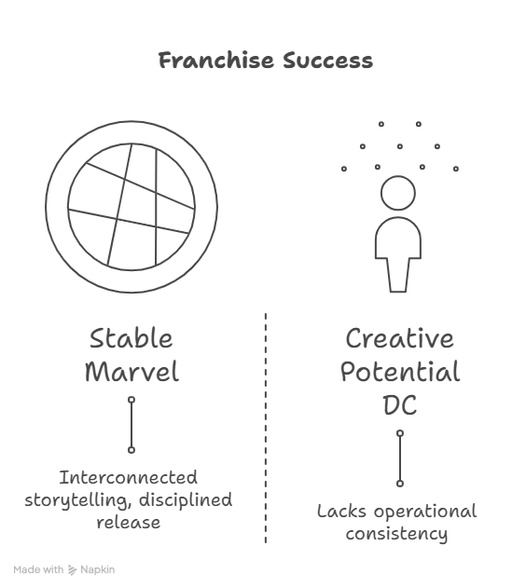
Conclusion
Strategic Implications
This analysis reveals that long-term franchise architecture — not individual film quality alone — drives sustained box office success.
Marvel demonstrates a more stable and commercially successful cinematic strategy, built on interconnected storytelling and disciplined release planning.
DC possesses significant creative potential but lacks the operational consistency required to compete at aggregate scale.
Key lesson: Data underscores the importance of long-term planning, universe coherence, and audience trust in driving franchise performance.
Notes:
8

Slide 9
Thank You

